Slide 1


SafeStress-ML
Trustworthy Multimodal Stress Detection via Tree-Based Ensembles and Explainable AI
Federica Picca
Computer Science course - AI, University of Bari Aldo Moro
ML exam
Prof.ssa Claudia d’Amato &
prof. Nicola Di Mauro

Slide 2


The impact of stress and the need for continuous monitoring
Today, chronic psychological stress is known as one of the biggest 'silent killers' of our century. It acts as a catalyst for severe heart diseases, weakens the immune system, and causes mental health disorders. In modern preventive medicine, seeing a doctor every few months is no longer enough. We need to monitor stress continuously, objectively, and without bothering the patient in their daily life.
Thanks to commercial wearable devices (like smartwatches), we can now track the responses of the Autonomic Nervous System.

Slide 3



Problems of Deep Learning paradigms
Deep Learning paradigms present some critical challenges for wearable healthcare:
The interpretability Black Box
Power & overfitting risks
Neural networks have massive numbers of parameters. They drain smartwatch batteries very quickly, making them useless for continuous, all-day monitoring.
Many published studies normalize all the data globally or mix all the data randomly. Because of this, the AI simply 'memorizes' the biological traits of specific people, rather than learning the true, universal patterns of stress.
Neural networks cannot explain why they make a decision. Doctors need transparency. Furthermore, recent European regulations, specifically the EU AI Act, legally require explainability for high-risk healthcare systems.

Slide 4

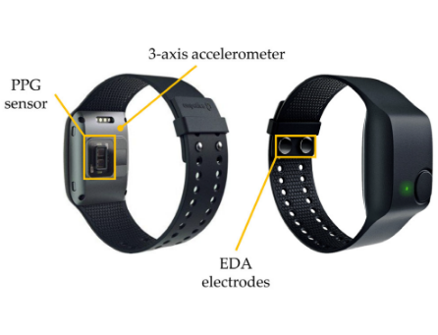
The SafeStress-ML solution
To solve these critical issues, I introduce SafeStress-ML. It avoids heavy neural networks.
To guarantee maximum clinical reliability, my system is built on three pillars:
Subject-Wise Normalization: to cancel out the individual genetic differences between people.
15-fold Leave-One-Subject-Out (LOSO) Validation: to guarantee that the model works on brand-new patients it has never seen before.
Explainable AI using TreeSHAP: to translate every mathematical alarm into a clear, physiological explanation for the doctor.

Slide 5

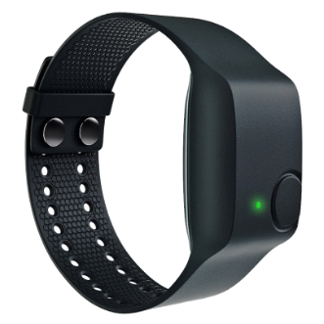
WESAD Bio-Sensor metrics
My project is validated on the gold-standard WESAD dataset, focusing exclusively on data from the wrist-worn Empatica E4 device to perfectly simulate a real-world consumer scenario.
Empatica E4 Sensory Stream
WESAD dataset benchmark evaluating physiological reactions of 15 subjects under acute stress (Trier Social Stress Test):
• Electrodermal Activity (EDA): logged at 4 Hz to monitor skin conductance sympathetic reactions.
• Blood Volume Pulse (BVP): logged at 64 Hz to track cardiovascular volume dynamics (PPG).
• Binary Label Balance: Class 1 (Stress, TSST) vs. Class 0 (Non-stress), producing an imbalanced 80:20 distribution.

Slide 6
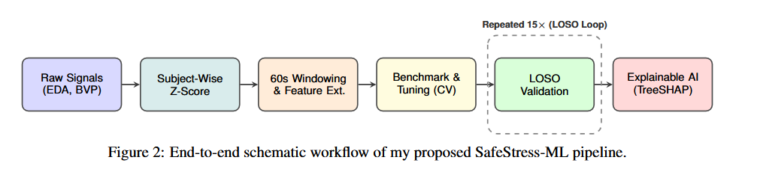
Proposed project pipeline
The SafeStress-ML architecture is built on a sequential pipeline designed for clinical edge-friendliness. It starts with raw signal acquisition, followed by subject-wise normalization and sliding window feature extraction. The core consists of a rigorous LOSO validation loop equipped with SMOTE balancing, culminating in a TreeSHAP explainability layer that translates mathematical outputs into actionable clinical insights.

Slide 7
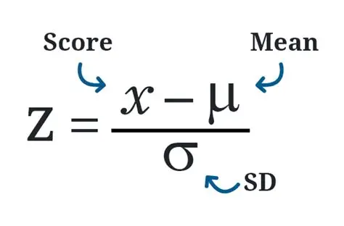
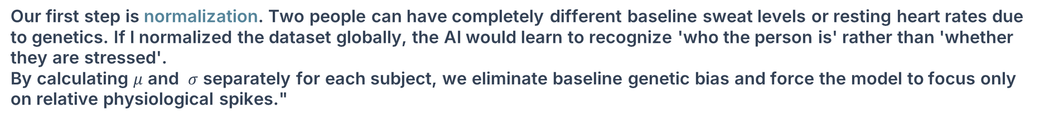
Normalization (Z-Score)
Our first step is normalization. Two people can have completely different baseline sweat levels or resting heart rates due to genetics. If I normalized the dataset globally, the AI would learn to recognize 'who the person is' rather than 'whether they are stressed'.
By calculating $μ$ and $σ$ separately for each subject, we eliminate baseline genetic bias and force the model to focus only on relative physiological spikes."

Slide 8
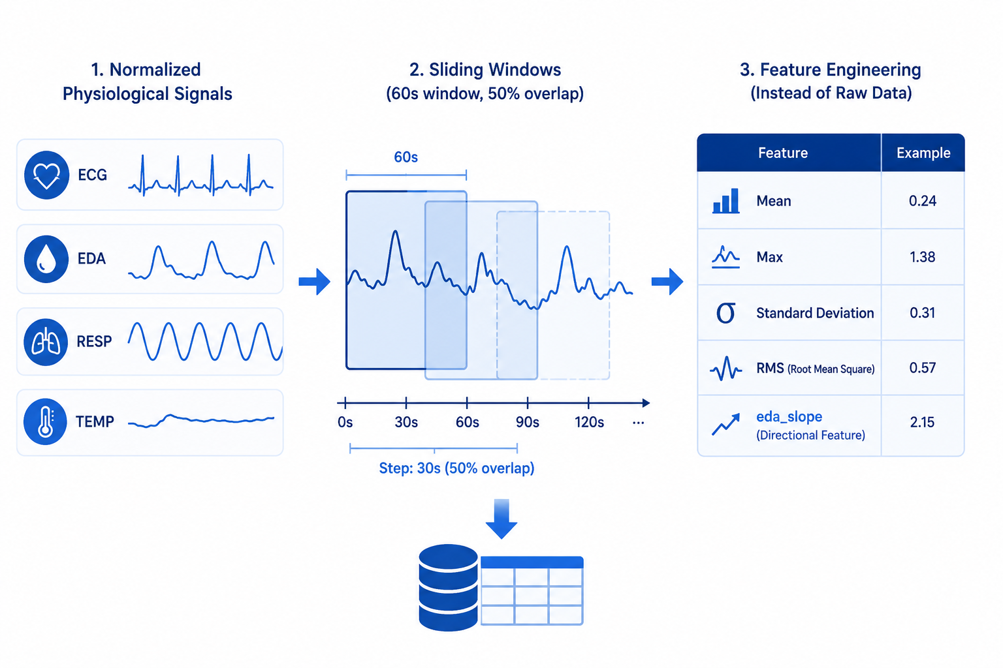
Windowing & feature extraction
After normalization, the continuous physiological signals are segmented into 60-second sliding windows with a 50% overlap. The overlap doubles our training instances without cutting stress peaks in half.
During development, I tested shorter 30-second windows, but the Macro F1-score dropped to 84.38%. The reason is biological: electrodermal responses are slow, taking 2 to 5 seconds to activate and several seconds to recover. A 60-second window is scientifically necessary to capture the complete temporal evolution of a sweat reaction.

Slide 9









Signal Feature Engineering
From these intervals, instead of feeding raw data, I engineered specific tabular features:
Statistical Metrics
Signal Energy (RMS)
Directional Slopes
Calculating the Root Mean Square (RMS) value within the 60s sliding windows to represent dynamic physical and sympathetic signal power changes.
Extracting Mean, Standard Deviation, Minimum, and Maximum markers across BVP and EDA raw signal segments to capture static changes.
Determining the eda_slope (difference between window end and window start) to index sudden spikes in sympathetic stress sweat.

Slide 10
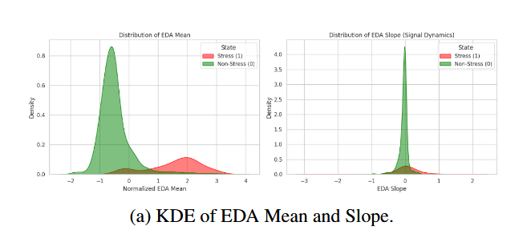
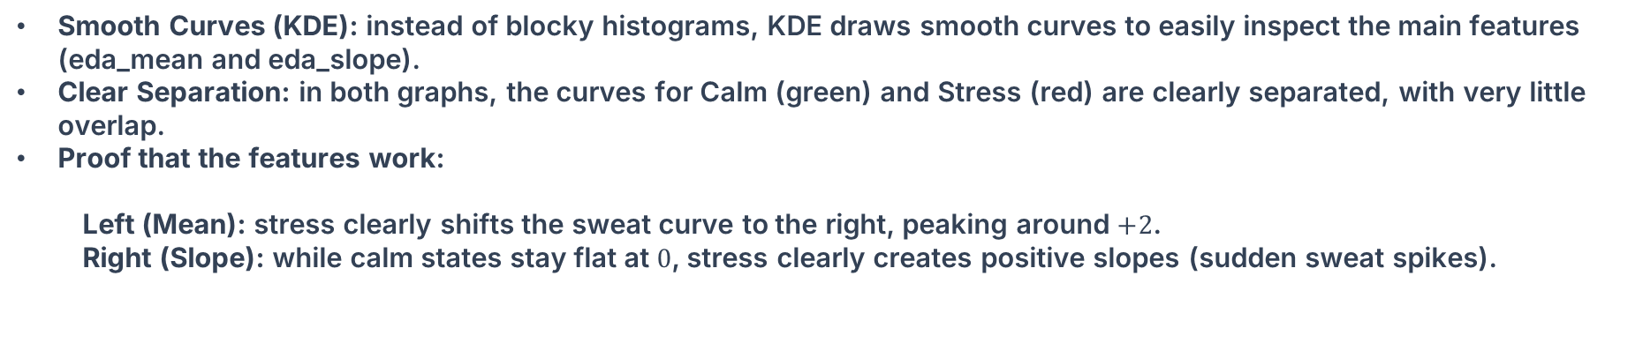
Feature Validation — Kernel Density Estimation (KDE)
Smooth Curves (KDE): instead of blocky histograms, KDE draws smooth curves to easily inspect the main features (eda_mean and eda_slope).
Clear Separation: in both graphs, the curves for Calm (green) and Stress (red) are clearly separated, with very little overlap.
Proof that the features work:
Left (Mean): stress clearly shifts the sweat curve to the right, peaking around $+2$.
Right (Slope): while calm states stay flat at $0$, stress clearly creates positive slopes (sudden sweat spikes).

Slide 11
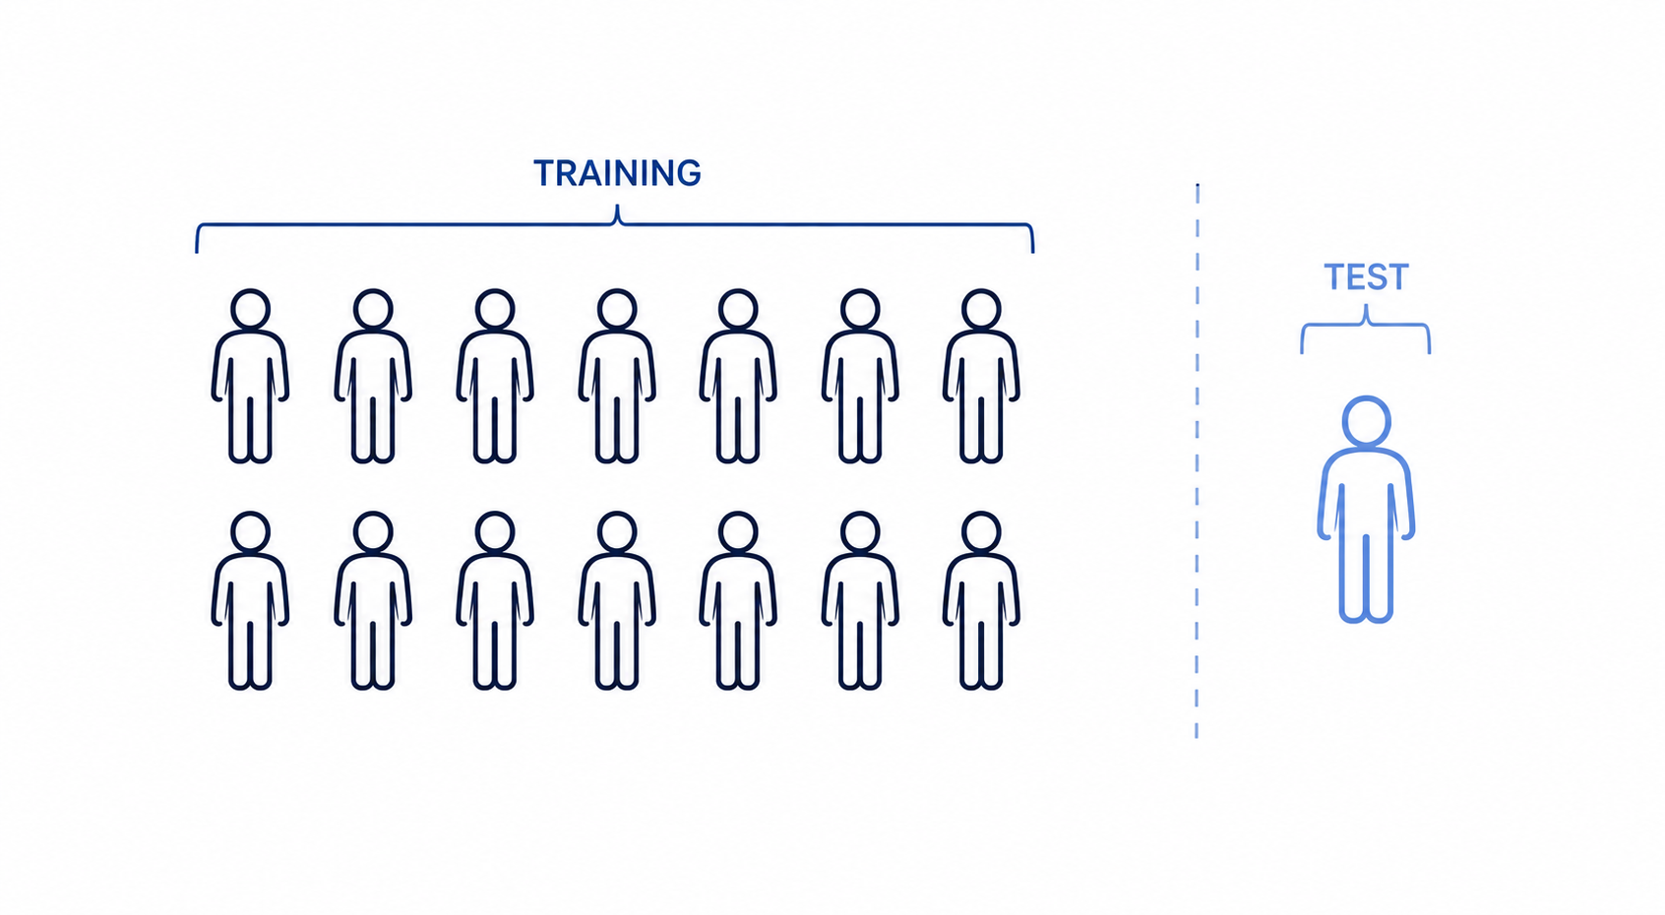
LOSO Validation & SMOTE
To handle the realistic 80:20 imbalance between calm and stressed states, I integrated the SMOTE technique to artificially oversample the minority class. Crucially, this was applied strictly within the training folds of a Leave-One-Subject-Out (LOSO) validation framework. By training on 14 subjects and testing exclusively on the 15th unseen subject, I completely eliminated data leakage, simulating a true real-world deployment on a brand-new patient.

Slide 12
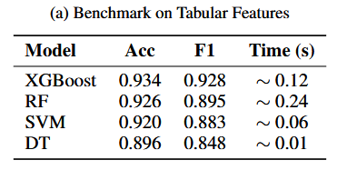
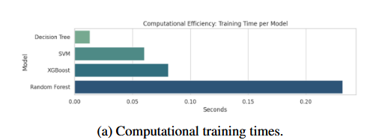
Benchmark e model selection
I benchmarked four distinct algorithms: Decision Tree, Support Vector Machine, Random Forest, and XGBoost. XGBoost emerged as the absolute winner with a Macro F1 of 0.928.
To optimize XGBoost, I used RandomizedSearchCV with 3-fold cross-validation, which randomly samples combinations from a defined search grid to find the optimal settings fast. The selected parameters are: 'n_estimators=200', 'max_depth=10', and class_weight = 'balanced_subsample' assigning heavier mathematical weights to the minority class.
Remarkably, it trained in just 0.12 seconds on a standard CPU, proving its immense superiority for low-power edge wearables.

Slide 13
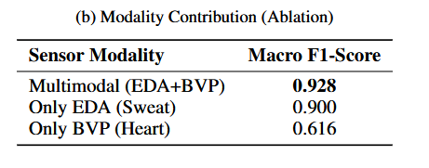
Modality Ablation study
To scientifically justify the use of multiple sensors, I conducted an Ablation Study. When the model relied only on heart metrics (BVP), performance dropped drastically to a 0.616 Macro F1-score. Heart rate alone is too noisy because it fluctuates with posture, movement, and breathing. Using only sweat metrics (EDA) yielded a strong 0.900, confirming sweat as the true backbone of sympathetic detection.
However, fusing both modalities achieved the highest score (0.928). This proves that EDA is the primary driver of stress detection, while cardiovascular data provides essential context to filter out false alarms.

Slide 14

Explainable AI (TreeSHAP)
The final step of the pipeline bridges the gap between machine learning and medicine. I integrated TreeSHAP to compute exact Shapley values for the tree ensembles. This layer acts as a clinical translator: instead of merely outputting a binary 'Stress' label, it provides exact mathematical transparency, showing a doctor exactly which physiological features drove the algorithm's decision in real-time.

Slide 15
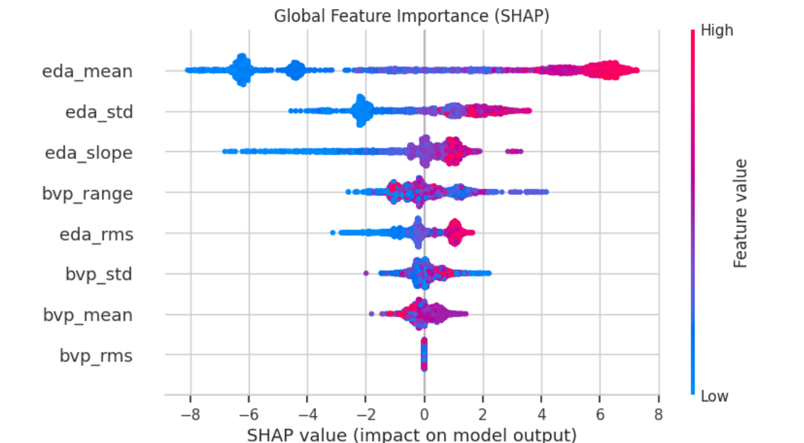
TreeSHAP global explanations
Using exact Shapley values derived through TreeSHAP to calculate clinical feature attributions in polynomial time.
The Global Summary Plot empirically validates our model's physiological logic: our engineered features, specifically eda_slope and eda_mean, emerge as the most powerful global predictors.
High skin conductance levels (red dots) are located entirely on the right side of the axis and consistently push predictions toward Stress (SHAP > 0). This mathematically proves that the algorithm does not rely on noise, but mirrors the diagnostic reasoning of a human doctor: rapid sweat increases indicate acute sympathetic stress.

Slide 16
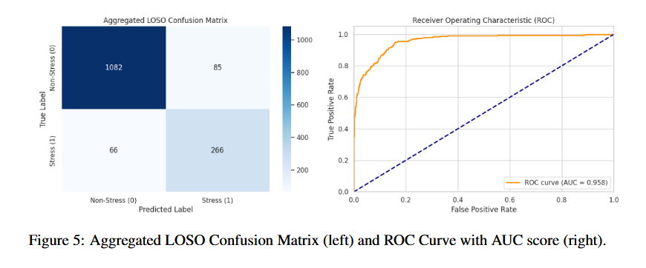
Clinical metrics & final results
Evaluated rigorously on unseen patients via the LOSO framework, SafeStress-ML achieved a final optimized Macro F1-score of 86.26%. The aggregated Confusion Matrix reveals that the model produced only 66 False Negatives across the entire dataset, which is a critical success for patient safety. Coupled with an impressive ROC-AUC score of 0.958, these metrics prove that the system is highly discriminative and incredibly safe for real-world preventive medicine.

Slide 17
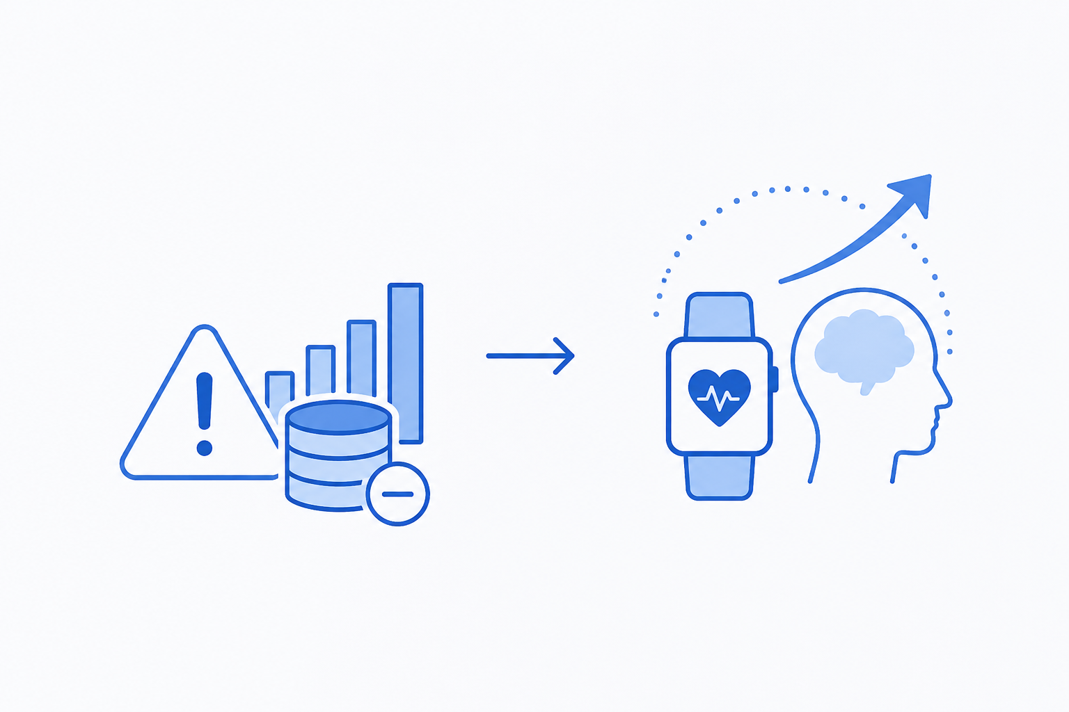
Limitations & future work
Despite robust generalization, the study faces limitations, such as a small dataset recorded in static laboratory conditions. Furthermore, subject S17 emerged as a biological outlier with only 42% accuracy. Future work will focus on dynamic transfer learning to personalize the algorithm for such individuals, and the integration of accelerometer data to provide context awareness, helping the smartwatch distinguish mental stress from physical exertion.

Slide 18

THANK YOU FOR THE ATTENTION
SafeStress-ML balances extreme computational efficiency with clinical safety and EU AI Act requirements.
Contact and github link:
https://github.com/FedericaPicca/ML_project_SAFESTRESS-ML.git
f.picca4@studenti.uniba.it

